Slide 1
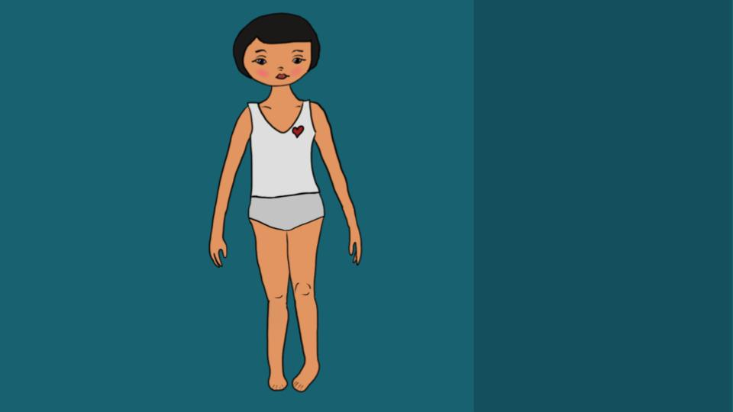
Notes:
In collaboration with @tiny_moon_star

